Slide 1
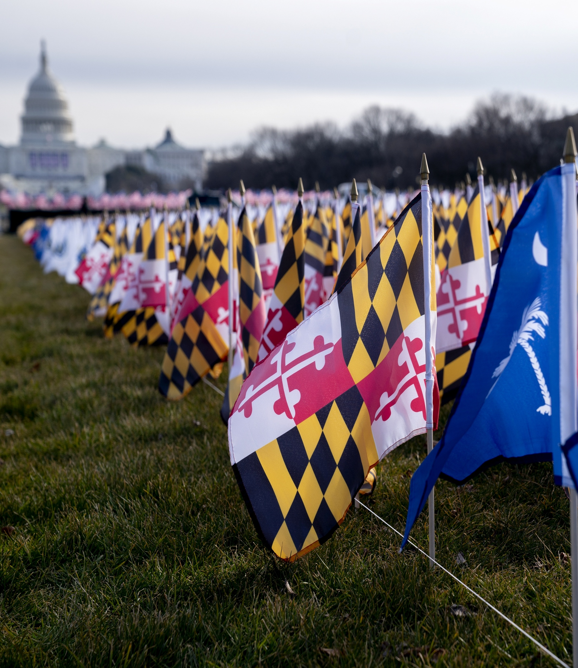
BLOOMBERG GOVERNMENT ONPOINT
Thirty-Nine States Adjourned With New Data Center, Privacy, AI, Tax Laws
July 10, 2026
Claire Hebert
State Legislative Analyst
Photo Credit: Stefani Reynolds/Bloomberg

Slide 2
About This OnPoint
Six more states adjourned by July 1, bringing the total that have gaveled out midway through the year to 39
Data centers saw new restrictions, including temporary pauses on permits in New York and on tax breaks in Arizona
  Virginia special session also ended with new energy use tax
June states continued trend of tackling data privacy and AI rules, imposing taxes on wealthy
Only a few states have legislative sessions left for this year
Massachusetts and California end in the summer
Pennsylvania, Michigan, New Jersey, North Carolina, and Ohio continue to meet until later in the year
IN THIS ONPOINT
Highlights of state sessions as of June 30
Look-ahead to future adjournments
KEY DATES TO WATCH
July 27: North Carolina returns from recess
July 31: Massachusetts formal session ends
Aug. 3: California returns from summer recess
Aug. 31: California adjourns
2
Photo Credit: Al Drago/Bloomberg
To contact the editors responsible: Danielle Parnass at dparnass@bloombergindustry.com; Amanda H. Allen at aallen@bloombergindustry.com; Naoreen Chowdhury at nchowdhury@bloombergindustry.com
Bloomberg Government

Slide 3
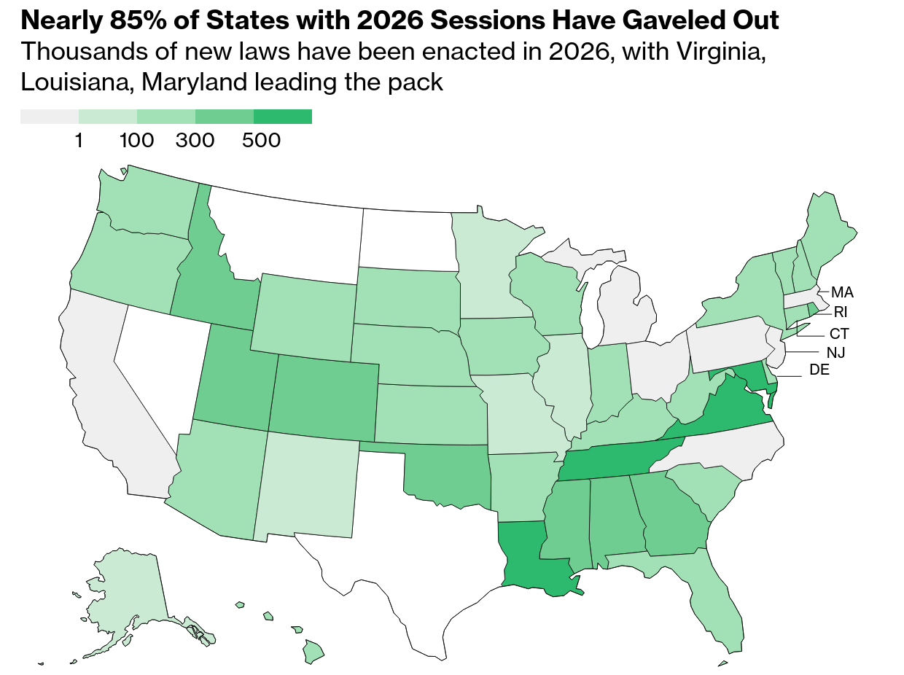
Data Center, Privacy, AI Laws Common Among June States
Notes: Bill data throughout this OnPoint is as of July 9, and totals generally don’t include resolutions or other types of measures. Gray states haven’t yet completed their regular sessions. White states aren’t holding regular sessions in 2026.
Source: Bloomberg Government analysis

Slide 4
State Legislative Sessions
June Adjournments

Slide 5
Arizona: Tax Conformity, Data Center, Voter ID Policies Pass
Key Legislation
Key Dates
HCR 2001 creates a ballot initiative for voters to decide whether to require ID for all forms of voting, including mail-in ballots, and allows for in-person tabulation of vote; the US Supreme Court is separately reviewing whether Arizona can require proof of citizenship when using state forms to register to vote
HB 4168 also creates a three-year moratorium on new sales tax breaks for data centers;
HB 2756 requires utilities to report on extra-high-load customers, such as data centers, and allows the state commission to set contract requirements, such as covering the cost of infrastructure improvements
HCR 2044 creates a ballot initiative for voters to decide whether to prohibit the state from promoting or funding policies that require preferential treatment based on race or ethnicity in education or hiring
HB 4168 conforms state taxes to the federal 2025 GOP tax bill, making it the only state to adopt full conformity, according to Republicans
HCR 2003 creates a ballot initiative for voters to decide whether to prohibit schools and athletic teams from allowing anyone to use a restroom and locker room that isn’t designated for that individual’s sex assigned at birth
JANUARY 12
Tax Conformity
Session commenced
FEBRUARY 20
Last day to be heard in committee in original chamber
Data Centers
JUNE 13
Session adjourned
Voter ID
WITHIN 10 DAYS
Deadline for governor action after adjournment or bills become law
Affirmative Action Rules
School Restroom Policy
260+ Enacted
Sources: Arizona Constitution; Arizona Session Laws

Slide 6
Louisiana: Privacy, Voter Citizenship, AI Deepfakes All Top Issues
Key Legislation
Key Dates
SB 347 adds digitally altered “deepfakes” to the definition of power-based violence for purposes of college reporting requirements; requires schools to provide information about how to identify and prevent power-based violence at least four times per year
HB 608 exempts from public disclosure requirements the total amount of money universities pay directly to student athletes or to a specific athletic program
HB 1137 prohibits public employers from punishing employees who refuse to use pronouns inconsistent with an individual’s sex assigned at birth, or any name other than their legal name
SB 386 creates a data privacy framework that allows consumers to access, correct, or delete their personal data, opt out of its sale and targeted ads
HB691 requires the secretary of state to submit voter rolls through the federal SAVE database and challenge registration of any noncitizens; the state separately sued the US Election Assistance Commission alleging it improperly blocked a 2024 law requiring proof of citizenship to register
MARCH 9
Privacy Framework
Session commenced
MAY 29
Last day to pass chamber of origin
Voter Registration
JUNE 1
Session adjourned
WITHIN 20 DAYS
Deepfake Reporting
Deadline for governor action after adjournment or bills become law
Employee Pronouns
Collegiate Athlete Pay
970+ Enacted
Sources: Louisiana Acts of the 2026 Regular Session; Louisiana Constitution

Slide 7
New York: Enacts Sweeping Budget, New Taxes, Privacy Protections
Key Legislation
Key Dates
Budget package includes a tax on second homes in New York City; delays climate benchmarks set in 2019; limits car accident insurance claims; and adds mechanism to cap excess utility company profits, require executive compensation disclosures
S 9934A would create first-ever law to restrict bots that scrape content from news sites; S 8451-B would require news organizations to disclose content created with AI; S 8706 would require larger companies to annually report how AI affects hiring
S 9005-C/A 10005-C bans masked ICE agents from operating in the state, prohibits civil immigration arrests in a school or church, bans local agencies from deputizing cops as immigration agents; allows individuals to sue federal officials for civil rights violations
A 9349-A would prohibit surveillance pricing that uses algorithms and personal data to set different prices for consumers; S 9269 would ban the sale of health data to third parties or process health information without authorization
S 10642 would create a one-year moratorium on new permits for large data centers; would require a public hearing before issuing permits, separate service classification for data centers, and facilities to use increasing amounts of renewable electricity sources
A 10379-C would ban the use of chatbots with features unsafe for minors, including features where AI content suggests it is a real person, uses mental health information, simulates companionship, or generates sexually explicit material
Budget, Tax Changes
JANUARY 7
Session commenced
JUNE 4
Data Centers
Session adjourned
WITHIN 30 DAYS
Deadline for governor action after adjournment or bills are automatically vetoed
AI Child Protections
AI Regulations
Data Privacy
Immigration Protections
140+ Enacted
Notes: The budget package includes several different pieces of legislation, including the immigration measure. ICE – US Immigration and Customs Enforcement.
Sources: Bills Recently Signed By the Governor; New York How A Bill Becomes Law

Slide 8

Highlights from Other State Legislative Sessions in June
State | Notable Legislation | Adjourned | Bills Enacted
Delaware | SB 75 preempts local laws that restrict where retail marijuana stores may operate, overriding Gov. Matt Meyer’s (D) 2025 veto of the measure HB 430 proposes a constitutional amendment to prohibit corporations and artificial entities from voting in elections; a court ruled corporations can vote in Delaware elections under some circumstances HB 233 would require utilities to establish a separate rate class for large energy use facilities, such as data centers | July 1 | 110
New Hampshire | HB 1460 prohibits the sale of a child's personal data HB 365 allows individuals without citizenship documentation to request verification through the secretary of state; HB 323 removes the ability to use student IDs to vote HB 1275 would grant immunity to farmers for damages related to per- and polyfluoroalkyl substances (PFAS) in soil, water, or agricultural products | June 4 | 240
Rhode Island | H 7127 creates a 3% surtax on personal annual income over $1 million SB 2203 requires genetic testing companies to disclose privacy policies to consumers on the use and disclosure of genetic data | June 11 | 300+
Note: Delaware was scheduled to adjourn June 30 but gaveled out after midnight on July 1.
Sources: Delaware Laws and library staff; New Hampshire Chaptered Final Versions; Rhode Island Public Law List

Slide 9
Most State Legislative Sessions Ended as of June
FEBRUARY MARCH
APRIL
MAY
JUNE
JULY
AUGUST – DECEMBER
New Mexico
Indiana
Utah
Oregon
Wyoming
Washington
Florida
Virginia
West Virginia
Wisconsin
South Dakota
Idaho
Georgia
Alabama
Kansas
Maryland
Mississippi
Kentucky
Nebraska
Tennessee
Maine
Arkansas
Iowa
Connecticut
Hawaii
Colorado
South Carolina
Oklahoma
Missouri
Minnesota
Alaska
Vermont
Illinois
Louisiana
New York
New Hampshire
Rhode Island
Arizona
Delaware
Massachusetts
California
North Carolina
Pennsylvania
Michigan
New Jersey
Ohio
Active special session
Adjourned special
Redistricting
Notes: States are ordered based on adjournment from regular session. Maryland is planning a special session on redistricting in August. Wisconsin opened a special session in March to address redistricting, and it is not currently meeting but hasn’t adjourned. North Carolina could adjourn as early as July. Montana, Nevada, North Dakota, and Texas aren’t holding regular sessions in 2026.

Slide 10
State Legislative Sessions
May Adjournments

Slide 11
Colorado: AI Law Replaced, Taxes Modified & Betting Restricted
Key Legislation
Key Dates
HB26-1223 creates an additional child tax credit and narrows a downloadable software sales tax exemption to apply only to custom software; HB26-1289 revises tax credits, deductions, and exemptions for businesses and individuals, expanding the tax base
SB26-131 prohibits sports betting operators from using push notifications to solicit bets, advertising to individuals younger than 21, and accepting deposits using a credit card or more than six deposits from one person per day
SB26-004 adds schools, healthcare facilities, and community responders to the list of groups that can petition the court for an extreme risk protection order against an individual possessing firearms, also known as red-flag laws
HB26-1322 allows individuals to sue a mental health professional for damages sustained during conversion therapy; follows a US Supreme Court ruling in April that held a 2019 Colorado ban on conversion therapy for minors likely violated free speech
SB 26-189 requires companies to disclose the use of AI for employment, financing, healthcare, and other “consequential” decisions; requires human review of decisions when requested; replaces a 2024 law that would have regulated algorithmic bias
JANUARY 14
AI Regulations
Session commenced
MARCH 20
Last day to pass chamber of origin
Tax Changes
MAY 13
Session adjourned
WITHIN 30 DAYS
Sports Betting
Deadline for governor action after adjournment or bills become law
Conversion Therapy
Red-Flag Laws
430+ Enacted
Sources: Colorado How a Bill Becomes a Law; 2026 Regular Session Laws; Colorado Deadline Schedule

Slide 12
Connecticut: Sweeping AI, Data Privacy, Employment Laws Passed
Key Legislation
Key Dates
SB 1 decouples parts of the state corporate tax code from the federal 2025 GOP tax law, including expensing for qualified production facilities and deductions for research costs
SB 4 requires data brokers to register with the state and allows consumers to request data deletion through one central location; prohibits selling precise geolocation data; prohibits retailers and delivery services from using personal data to set prices
HB 5003 requires job advertisements to contain pay ranges, employers to provide additional break times for nursing mothers, and healthcare workers and teachers who cannot work because of an assault to receive 100% of their average weekly earnings
HB 5001 removes eligibility requirements to receive an absentee ballot, allowing any voter to request one
SB 5 requires companies disclose AI use for employment decisions; requires AI chatbot operators to address risks of self-harm and developers to maintain whistleblower procedures; requires platforms to verify users’ age and limit efforts to target minors
HB 5350 removes a requirement that medical cannabis be dispensed by a pharmacist and allows out-of-state patients to obtain medical cannabis; SB 1 replaces three separate cannabis taxes with one 10.75% tax on a retailer’s gross receipts
FEBRUARY 4
Federal Tax Decoupling
Session commenced
MAY 6
AI Regulations
Session adjourned
WITHIN 15 DAYS
Deadline for governor action after adjournment or bills automatically become law
Data Privacy
Employment Changes
Cannabis
Rules & Tax
Absentee Ballots
180+ Bills Enacted
Note: Several provisions in SB 5, SB 4, and HB 5350 were also modified by HB 5222.
Sources: Governor Bill Notifications; Connecticut Enactment of Bills; Connecticut Committee Deadlines Calendar

Slide 13
Illinois: Crypto Taxes, Rules for AI and Social Media Enacted
Key Legislation
Key Dates
HB 2371 prohibits drug companies from interfering with drug dispensing to hospitals and pharmacies in the 340B drug discount program
SB 0315 requires developers of advanced AI models to publish risk mitigation efforts, conduct third-party compliance audits, and report critical safety incidents; creates civil penalties including up to $1 million for a first violation
HB 5511 would require devicemakers and app stores to provide apps and websites with a user’s age bracket and prohibits use of algorithmic feeds and auto-play for kids;
SB 2427 would require schools adopt policies limiting cellphone use during school time
SB 3222 creates a regulatory framework for intoxicating hemp products and requires all products be produced and sold by licensed businesses; bans hemp product manufacturers from creating artificially derived cannabinoids
SB 3645 delays for another year a 2024 law to ban credit card swipe fees that banks charge on retail taxes and tips until July 2027; a federal judge and the NCUA said in June the law doesn’t apply to national banks or federal credit unions
SB 3019 imposes new taxes on: cryptocurrency users at 0.2% of a digital asset’s value; prediction markets wagers tied to sports; targeted advertising services; and social media platforms based on the number of monthly Illinois users
New Tax Frameworks
JANUARY 13
Session commenced
APRIL 17
AI Safety Regulations
Last day to pass chamber of origin
MAY 31
Online Child Protections
Session adjourned
WITHIN 60 DAYS
Deadline for governor action after presentment or bills become law
Credit Card Fees
Hemp Rules
Drug Program
80+ Bills Enacted
Notes: NCUA – National Credit Union Association
Sources: Illinois Session Schedule; Illinois Constitution Article IV; Illinois Public Acts

Slide 14
Minnesota: Prediction Markets, AI, Social Media Regulated
Key Legislation
Key Dates
HF 2438 provides a one-time increase in the homestead credit refund for property taxes in 2026 and decouples from federal tax law on immediate expensing of research expenditures, while largely aligning with other provisions; a previous version would have imposed taxes on technology companies and wealth above $10 million
HF 4138 requires social media companies to estimate a users’ age, obtain parental consent for child accounts, and automatically default those accounts to the most private settings; prohibits addictive features and paid advertising on children's accounts
SF 4760 imposes a first-of-its-kind ban on prediction markets, making it a felony to operate or advertise the platforms; the federal government has challenged the law, saying it encroaches on the CFTC’s exclusive jurisdiction
HF 1606 prohibits companies from allowing users to alter an image or video to depict an intimate body part not depicted in the original content of an identifiable individual; establishes penalties and a cause of action for individuals depicted
FEBRUARY 17
Tax
Changes
Session commenced
MAY 18
Session adjourned
WITHIN 14 DAYS
Deadline for governor action after adjournment or bills are vetoed
Prediction Market Ban
Social Media Rules
AI Regulations
90+ Bills Enacted
Note: CFTC – Commodity Futures Trading Commission
Sources: Minnesota Legislative Reference Library; Committee Deadlines; Minnesota Constitution; Minnesota Session Laws

Slide 15
Missouri: Income Tax Measure, Sentencing Overhaul Passed
Key Legislation
Key Dates
SB 999 would require healthcare providers to provide medical care to an infant that survives an abortion attempt; a person would be guilty of first-degree murder for knowingly performing an overt act that results in death (delivered to governor)
SB 888 increases the amount of time inmates must serve before being eligible for parole; allow prosecutors to request juveniles be tried as adults for serious felonies and counties to open juvenile detention facilities
HB 2641 requires all intoxicating hemp products to be regulated as marijuana and produced and sold only by state-licensed marijuana dispensaries
HB 2372 prohibits hospitals that don’t comply with federal price transparency laws from pursuing patient collection actions; prohibits PBMs from discriminating against hospitals that received discounted drugs under 340B program (delivered to governor)
HJR 173 & 174 create a ballot initiative for Missourians to vote on whether to allow lawmakers to gradually phase out income tax and potentially expand sales taxes; courts recently ruled the ballot question could move forward
JANUARY 7
Income Tax Vote
Session commenced
MAY 15
Criminal Justice Overhaul
Session adjourned
WITHIN 45 DAYS
Deadline for governor action after adjournment or bills automatically become law
Abortion Rules
Healthcare Changes
30+ Bills Enacted
Hemp Rules
Sources: Missouri Legislative Process; Governor Action on Bills

Slide 16
South Carolina: Lower Income Taxes, Tech Rules Set in New Laws
Key Legislation
Key Dates
H 4756 requires public schools’ restrooms and changing facilities be designated for one sex at a time, and used only by students assigned that sex at birth; noncompliant schools would lose 25% of appropriated funds for the school’s operation
S 477 allows pharmacists to dispense hormonal contraceptives, such as birth control or hormonal rings, without a physician prescription based on standard protocols issued by a medical board
H 4216 consolidates personal income taxes to two brackets instead of three and lowers the top rate to 5.21% from 6%, with further reductions phased in each year that the state meets revenue targets
H 3431 requires tech companies to let users disable addictive design features such as infinite scrolling and auto-play, and to exercise reasonable care to prevent harm to minors; tech trade group is challenging the law in court
H 4303 imposes a 5-cent tax on vapor products and e-cigarettes and 2.14-cent tax per cigarette for heated tobacco products; proceeds will go toward state’s Medicaid Reserve Fund
JANUARY 13
Tax Cuts
Session commenced
MAY 14
MAY 14
Session adjourned
Vape Tax
WITHIN 2 DAYS OF NEXT SESSION
Deadline for governor action after adjournment or bills become law
Social Media Rules
MAY–JULY
Special session addressing budget, redistricting
School Restroom Policy
270+ Bills Enacted
Pharmacist Authority
Sources: South Carolina Legislature Schedule; South Carolina Constitution; Session 126 by the Numbers

Slide 17
Highlights from Other State Legislative Sessions in May
State | Notable Legislation | Adjourned | Bills Enacted
Alaska | HB 195 allows pharmacists to prescribe medication that isn’t a controlled substance and doesn’t require a new diagnosis SB 187 prohibits certain food dyes from being served in public school meals | May 20 May–July special | 50+
Hawaii | SB 3125 creates a 13% tax bracket for households earning more than $1 million per year; continues tax cuts passed in 2024 that Gov. Josh Green (D) proposed pausing SB 2471 prohibits corporations from spending money or participating in any election or ballot activity effective July 1, 2027 | May 8 | 200+
Iowa | SF 2480 imposes a 5-cent tax on vapes and alternative nicotine products; HF 2739 temporarily increases a tax on Medicaid health maintenance organizations SF 2472 overhauls the property tax framework, caps all levies at 2% annually SF 579 preempts localities’ antidiscrimination laws; HF 2711 removes state’s affirmative action hiring policy and implicit bias training requirements for police | May 3 | 200
Sources: Alaska Session Law; Hawaii Acts; Iowa Legislation Signed By Governor

Slide 18
Highlights from Other State Legislative Sessions in May (Cont.)
State | Notable Legislation | Adjourned | Bills Enacted
Oklahoma | SB 546 creates a data privacy framework that allows consumers to access, correct, and delete personal information as well as opt out of targeted ads and data sales SJR 47 creates a ballot initiative for voters to decide whether to approve a constitutional amendment that requires voters provide identification at the polls HB 1276 prohibits students from using cell phones and electronic devices during school hours | May 14 | 450+
Vermont | S 71 creates a data privacy framework that allows consumers to access, correct, or delete their personal data, opt-out of its sale and targeted ads; H 211 increases fees for data brokers, require more disclosures on data they collect H 816 prohibits companies from offering mental health services using AI; S 23 requires election-related content to disclose whether it’s been manipulated by AI S 209 prohibits civil arrests, including for immigration, in sensitive areas such as a school, public library, or healthcare facility | May 29 | 100+
Sources: Oklahoma Governor Action Report; Vermont Acts & Resolves

Slide 19
State Legislative Sessions
April Adjournments

Slide 20
Georgia: Bills Alter Tax Code, Target Immigration & Insurance Fraud
Key Legislation
Key Dates
Key Dates
HB 1009 prohibits high school students from using personal electronic devices during the school day
HB 463 gradually reduces the personal income tax rate to 3.99% from 5.19%, exempt up to $1,750 in cash tips and overtime, and eliminate some business tax credits; an earlier version would have eliminated data center tax breaks
HB 1199 suspends the collection of excise tax on gasoline for 60 days and conforms to GOP tax law, while decoupling some business tax breaks; HB 1000 creates a one-time tax rebate of $250 for single filers or $500 for married couples
HB 295 allows property owners to sue local governments for failing to enforce prohibitions on immigration sanctuary policies or laws related to homeless and public safety if it reduces their property values
SB 33 allows local governments to adopt a 1% sales and use tax to offset property tax deductions
SB 220 allows individuals to possess up to 12,000 milligrams of THC for medical purposes and remove the requirement that covered medical conditions are severe or end stage
Income Tax Cuts
JANUARY 12
Session commenced
Gas Tax, Conformity, Rebates
MARCH 6
Last day to pass chamber of origin
APRIL 2
Homestead Property Tax
Session adjourned
WITHIN 40 DAYS
Deadline for governor action after adjournment or bills become law
Immigration & Nuisance Lawsuits
JUNE
Special session addressed some voting measures
School Phone Ban
Medical Cannabis
350+ Bills Enacted
Sources: 2026 Signed Legislation, Georgia Life of A Law

Slide 21
Kentucky: Legislature Overrides Governor Veto on Multiple Issues
Key Legislation
Key Dates
Key Dates
HB 757 imposes a first-in-the-nation, 14.25% tax on prediction market operators’ transaction fees; partially conforms to federal tax provisions with some exceptions, including provisions related to overtime, tips, and domestic research
HB 2 codifies new federal work requirements, sets copayments for Medicaid enrollees at $5 for medical services and $1 for prescription drugs, and prohibits coverage of drugs prescribed primarily for weight loss
SB 57 creates a Nuclear Reactor Site Readiness Pilot Program to provide grants of up to $25 million to help utilities obtain permits for proposed sites of new nuclear energy generating facilities
HB 78 provides immunity to gun manufacturers, sellers, and trade associations from civil lawsuits, preempting local laws; HB 312 allows individuals ages 18 to 20 to obtain a provisional concealed carry permit
HB 139 requires proof of citizenship before voting, allowing individuals to cast a provisional ballot by attestation; removes Social Security and public benefit cards from the list of acceptable ID at polls; allows judicial candidates to disclose political party
JANUARY 6
Tax Changes
Session commenced
APRIL 15
Session adjourned
Voter ID & Citizenship
WITHIN 10 DAYS
Deadline for governor action after transmittal or adjournment or bills become law
Medicaid Coverage
Firearm Regulations
Nuclear Energy
190+ Bills Enacted
Sources: Kentucky 2026 Laws; Kentucky Constitution

Slide 22
Maryland: Data, Labor, Immigration, and Voting Bills Pass
Key Legislation
Key Dates
Key Dates
SB 385 requires the Maryland Department of Health to make vaccine recommendations that follow generally accepted scientific consensus and clinical guidance
SB 417 bans employers from penalizing employees for not attending an employer-sponsored meeting where the employer opines on union membership or religious and political matters
SB245 bans state entities from entering federal immigration enforcement agreements; SB791 limits detaining practices; SB792 requires hospitals to adopt enforcement protocols; SB810 allows schools to deny law enforcement access without a warrant
SB 334 prohibits manufacturing, selling, or transferring firearms that can be converted into machine guns
SB 255 prohibits voting practices that impair a protected class’ ability to influence an election, the Supreme Court in April limited similar provisions in the 1965 Voting Rights Act; HB 263 requires nearby bus routes to stop near voting locations entrance
HB 895 prohibits a food retailer or third-party delivery service from using consumer data to set dynamic prices for goods or services
Dynamic Pricing
JANUARY 14
Session commenced
MARCH 23
Anti-Union Meetings
Last day to pass chamber of origin
APRIL 13
Immigration Enforcement
Session adjourned
WITHIN 30 DAYS
Deadline for governor action after transmission or bills become law
Voting
Access
AUGUST
Special session to address redistricting
Machine Gun Ban
Vaccine Authority
880+ Bills Enacted
Sources: Maryland Legislation, Session Dates, Constitution

Slide 23
Highlights from Other State Legislative Sessions in April
State | Notable Legislation | Adjourned | Bills Enacted
Alabama | HB 161 requires app stores to request an individual’s age category and obtain parental consent before a minor can download an app SB 270 directs the state regulatory commission to consider data centers’ incremental cost recovery when reviewing proposed contracts with public utilities HB 351provides consumers the right to access, correct, or delete personal data and opt out of targeted ads and data sales | April 9 May special | 400
Arkansas | HB 1001 / SB1 lowers the top individual income tax rate to 3.7% beginning in 2026 and reduces the top corporate income tax rate to 4.1% beginning in 2027 | April 29 May special | 170+
Idaho | HB 822 requires schools and health providers to notify parents when a child asks to change their pronouns, or use bathrooms or play on teams of another gender HB 752 creates a misdemeanor crime for entering a restroom in a government building that doesn’t align with sex assigned at birth; law being challenged in court HB 559 conforms with most provisions of the 2025 GOP tax bill | April 2 | 340+
Kansas | HB 2602 allows companies to contribute to gig worker portable benefit accounts without affecting employment classification; contributions would be tax deductible HB 2700 requires equipment manufacturers to make replacement parts or tools available to repair providers for digital electronic equipment that costs $50 or more HB 2635 prohibits local laws requiring pregnancy centers to offer abortion services and establishes a civil cause of action | April 10 | 150+
Note: Kansas first adjournment was March 27 followed by a veto session April 9–10.
Sources: Alabama Bill List; Arkansas Acts; Idaho Enacted Legislation; Kansas Bill Reports

Slide 24
Highlights from Other State Legislative Sessions in April (Cont.)
State | Notable Legislation | Adjourned | Bills Enacted
Maine | LD 2212 applies a 2% surtax on annual incomes over $1 million LD 517 requires political ads to disclose when they contain AI-generated content LD 2106 prohibits teachers and public employees from voluntarily permitting entry to law enforcement officers for immigration purposes | April 29 | 270+
Mississippi | HB 1613 prohibits the manufacture, dispensing, or prescribing of abortion pills HB 908 eliminates a 5-day grace period for counting mail-in ballots after an election if Supreme Court rules they must be received by Election Day | April 15 | 370+
Nebraska | LB 258 creates a $13.50 minimum wage for youth ages 14 to 16, down from state’s $15 rate for other workers; increases rates by 1.75% each year instead of by inflation LB 1261 prohibits public utilities from using eminent domain to acquire a privately owned facility that’s tied to a data center or other large industrial customer, and requires industrial customers pay all related costs incurred by a public utility | April 17 | 160+
Tennessee | HB 2219 requires sheriffs to join a federal program to enforce immigration laws; other immigration bills include requiring public agencies to verify work authorization status and citizenship status for public benefits SB 2040 prohibits pharmacy benefit managers from owning a pharmacy, regardless of the percentage of ownership SB 1469 prohibits minors younger than 14 from working as content creators | April 23 May special | 610+
Sources: Maine Session Law; Mississippi Report of All Measures; Nebraska Final Worksheet; Tennessee Public Acts

Slide 25
State Legislative Sessions
February/March Adjournments

Slide 26
Florida: Taxes, Energy, and Voting Top List of Passed Legislation
Key Legislation
Key Dates
HJR 1-F creates a ballot measure for voters to decide whether to cap property tax increases at 5% rather than 10% beginning in 2027 and to increase a homestead tax exemption to $150,000 of assessed properties in 2027 and $250,000 in 2028
HB 7031 excludes from the state’s tax structure key corporate tax breaks enacted under the 2025 GOP tax law, while conforming to the rest of the federal law as of 2026
HB 1217 prohibits a governmental entity from enacting or enforcing initiatives related to net-zero emissions policies, including as a condition of a contract
HB 757 expands to public universities a program allowing faculty to carry guns on campus after completing training program; creates a second-degree felony for discharging a firearm within 1,000 feet of a school
HB 991 requires voters to provide evidence of US citizenship to register or remain on registration list beginning in 2027 and limits the list of acceptable identification to government-issued photo ID; law is being challenged in court
SB 484 requires data centers to bear the full cost of service for their electrical load; public utilities also couldn’t provide electric service to a data center that’s a foreign entity
JANUARY 13
Property Tax
Session commenced
MARCH 13
Tax Decoupling
Session adjourned
WITHIN 15 DAYS
Deadline for governor action after transmission or bill becomes law
Data Centers
APRIL-JUNE
April special session addressed redistricting
May session addressed state budget; property taxes over the summer
Greenhouse gas rules
Voter ID & Citizenship
Bill Stats
Firearm Program
220+ Bills Enacted
Sources: Florida Legislature Statistics Report; Regular Session Dates; Florida Constitution

Slide 27
Indiana: Short Session Tackles Tax, Environment, Immigration Laws
Key Legislation
Key Dates
SB 78 requires schools to adopt a cell phone policy for school days that institutes storage rules or bars device use; provides immunity to schools from civil liability for good-faith actions to comply
HB 1001 limits impact fees on new development and caps building permit fee increases; requires local governments to examine their ordinances and zoning regulations with the goal of increasing housing development
SB 243 conforms Indiana’s tax code to Republicans’ 2025 federal tax law regarding tax exemptions for tipped and overtime income and car loan interest for the 2026 tax year; decouples from federal tax relief provisions for businesses
SB 76 allows the state attorney general to sue public entities for failing to comply with immigration inquiries; requires local agencies to comply with federal detainer requests and prohibits businesses from employing unauthorized immigrants
SB 277 restructures state environmental agency mandates; prohibits decision making based solely on federal risk values that haven’t been promulgated through federal rulemaking; removes state agency reporting requirements
DEC. 1, 2025
Tax Conformity
Session commenced
JANUARY 29
Last day to pass chamber of origin
Environment Rules
FEBRUARY 27
Session adjourned
WITHIN 7 DAYS
Immigration
Laws
Deadline for governor action after bill is transmitted or it becomes law
Housing Supply
School Phone Ban
160+ Bills Enacted
Sources: Indiana 2026 Bill Watch, How a Bill Becomes a Law

Slide 28
New Mexico: Taxes, Immigration, Affordability Are Common Themes
Key Legislation
Key Dates
SB 241 codifies universal child care program and establishes requirements for program administration, including use of a cost estimation model for provider reimbursement rates based on facility type, age group served, facility quality rating
SB 151 affirmatively decouples the state tax framework from the 2025 GOP federal tax law and creates a new state tax credit and exemption programs benefiting local news organizations, physicians, and developers of affordable housing
HB 99 creates caps on punitive damages based on type of provider and requires plaintiffs to provide clear and convincing evidence that a provider’s actions were malicious or willful
HB 9 prohibits public agencies from entering into or continuing agreements to detain individuals for federal civil immigration violations
HB 200 provides loans for first-time homebuyers to purchase starter homes from eligible builders; applies to buyers with income below 120% of the area median income
JANUARY 20
Tax Decoupling
Session commenced
FEBRUARY 19
Session adjourned
Immigration Laws
WITHIN 20 DAYS
Deadline for governor action after adjournment or bills are pocket vetoed
Medical Malpractice
Homebuyer Program
Childcare Program
70+ Bills Enacted
Sources: Session Dates, 2026 Signed and Chaptered Bills

Slide 29
Oregon: Laws Restructure Tax Programs to Balance Budget
Key Legislation
Key Dates
SB 1507 affirmatively decouples the state tax framework from parts of the 2025 GOP federal tax law, including auto loan interest deduction, small-business stock exemption, and part of the bonus depreciation deduction
SB 1510 extends through 2027 the pass-through entity elective tax, which was created under a 2021 law in response to the 2017 federal tax law that instituted a $10,000 cap on the state and local tax deduction
HB 4088 prohibits cooperation with federal or other state law enforcement agencies that are investigating legally protected reproductive or gender-affirming care; prevents disclosure of related health records containing personally identifiable information
SB 1599 moves a ballot measure, with which voters will approve or reject parts of a 2025 law that would raise the state’s gas tax, to the May primary from the November general election; the date change is being challenged in court
HB 4138 requires federal law enforcement agencies operating in the state to have officers clearly display their name and agency and prohibits officers from wearing face masks; SB 1587 prohibits public agencies from disclosing personal information to a data broker if the information could be sold for federal law enforcement purposes
FEBRUARY 2
Tax Decoupling
Session commenced
MARCH 8
Session adjourned
SALT Cap Workaround
WITHIN 30 DAYS
Deadline for governor action after bill is transmitted or it becomes law
Gas Tax
Vote
Immigration Laws
Healthcare
140+ Bills Enacted
Sources: Governor Signed Bills - 2026 Regular Session, Legislative Calendars, Oregon Legislative Process

Slide 30
Utah: Key Laws Focus on Energy Sector, Big Tech, and Pharma
Key Legislation
Key Dates
HB 76 requires large data centers to notify water providers of consumption needs and status before beginning construction and requires annual reporting
HB 498 modifies Utah’s 2025 law on app store age checks, which is being challenged in court, including to apply to pre-installed apps and extend compliance until 2027
HB 527, as amended, requires pharmacy benefit managers to provide evidence of the pharmacy acquisition cost to deny appeals of a drug’s maximum allowable cost; the bill’s original language would have prohibited PBMs from engaging in spread pricing
SB 287 imposes a 4.7% tax on companies that deliver targeted advertising; SB 162 applies sales tax to all streaming and downloaded content; SB 73 imposes a new 2% excise tax on pornographic website subscriptions
SB 174 outlines rights for refusing to provide health services for religious reasons;
HB 174 prohibits providing gender-affirming hormones to minors; HB 258 requires health insurers to cover gender transition reversing procedures
HB 222 creates a first-in-the-nation law to limit companies’ liability for damages caused by greenhouse gas emissions, unless they violate a specific restriction or permit
Greenhouse Gas Liability
JANUARY 20
Session commenced
MARCH 3
Data Centers
Last day to pass chamber of origin
MARCH 6
Session adjourned
App Store Controls
WITHIN 20 DAYS
Deadline for governor action after adjournment or bills become law
Digital Taxes
PBM Oversight
Transgender Care
490+ Bills Enacted
Sources: 2026 General Session Bills Passed, Utah Session Dates

Slide 31
Virginia: Bills Cover Affordability, Environment, Data Privacy
Key Legislation
Key Dates
HB 1/SB 1 increases the state minimum wage to $13.75 per hour effective Jan. 1, 2027, and to $15.00 per hour effective Jan.1, 2028; rate would be adjusted for inflation annually after that
SB 361 requires insurers cover contraceptive drugs and prohibits insurers from charging copays, coinsurance, or other fees
SB 749 bans the sale of any assault weapons and designates the crime as a
Class 1 misdemeanor; also prohibits the sale of a large capacity ammunition feeding device
SB 338 prohibits entities from selling consumers’ precise geolocation data
HB 29 directs state agencies to rejoin the Regional Greenhouse Gas Initiative; HB397/SB802 codifies requirement to maintain a market-based trading program consistent with the initiative to reduce emissions from power plants
HB 30 imposes a first-of-its-kind tax on data centers’ electricity usage based on 1.1 cents per kilowatt-hour of electricity consumed; the legislation preserves the existing sales tax exemption in state law
Data Center Tax
JANUARY 14
Session commenced
FEBRUARY 17
Minimum Wage
Last day to pass chamber of origin
MARCH 14
Session adjourned
Health Costs
WITHIN 30 DAYS
Deadline for governor action after adjournment or bills become law
Cap-and-Trade Pact
APRIL-JUNE
Special session extended to resolve state budget
Data Sale Ban
Assault Weapon
Ban
1,130+ Bills Enacted
Sources: 2026 Regular Session Statistics, Virginia Constitution

Slide 32
Washington: Taxes, Workplace Protections Stand Out in New Laws
Key Legislation
Key Dates
HB 1916 outlines new requirements for challenging an individual’s voter registration and increases evidentiary standard; establishes a misdemeanor crime for knowingly challenging a registration without reasonable cause
SB 6346 applies a 9.9% tax — the state’s first personal income tax — on individuals who earn more than $1 million per year, excluding home value; the law could be challenged based on a 1933 court decision that blocked graduated income taxes in the state
HB 2471 provides the state labor board with authority over private sector collective bargaining if federal labor laws are rolled back or not enforced; similar laws in California and New York have been temporarily blocked in court
SB 6231 eliminates a tax exemption for data centers when refurbishing equipment and any existing exemption certificates would expire July 1, 2026
HB 2105 requires employers to provide written notice of any federal inspections of I-9 employment eligibility forms and related worker records to each worker within five business days of receiving notification from a federal agency
JANUARY 12
Millionaire’s Tax
Session commenced
FEBRUARY 17
Last day to pass chamber of origin
Data Center Taxes
MARCH 12
Session adjourned
WITHIN 20 DAYS
Immigration Laws
Deadline for governor action after adjournment or bills become law
Labor Unions
Voter Registration
270 Bills Enacted
Sources: Session Documents, Governor Bill Actions

Slide 33
Highlights from Other State Legislative Sessions in March
State | Notable Legislation | Adjourned | Bills Enacted
South Dakota | HB 1038 allows a public utility to charge a data center for the actual electrical costs attributable to them, for those with a peak demand of ten megawatts or greater SB 45 prohibits the sale of intoxicating cannabinoid products to anyone younger than 21 | March 30 | 240
West Virginia | SB 392 reduces personal income taxes by 5%; SB393 and SB400 align state tax code with permanent provisions of the 2025 GOP federal tax bill HB 4009 establishes a voluntary portable benefit plan for gig workers | March 14 | 290+
Wisconsin | AB 180 prohibits the use of food access benefits to purchase candy and soda | March 19 April special | 160+
Wyoming | HB 96 reduces the required age for a concealed carry permit to 18 from 21 SF41 creates portable benefit accounts for gig workers and allows employers to contribute to them without affecting their employment classification | March 11 | 100+
Sources: South Dakota Bills Signed by the Governor; West Virginia Actions by Governor; Wisconsin Chaptered Acts; Wyoming 2026 Budget Session

